Slide 1
Measure C Regional Program
Capital Projects, Safety/Operational Improvements and Congestion Relief

Slide 2
Regional Projects Defined
Regional projects are generally considered those streets, roads, highways, freeways or other facilities used daily by the residents of multiple communities.
The original Measure C in 1986 invested 75 percent of its funding into the Regional Program with a vision of opening, extending or widening State Routes 41, 99, 168 and 180 in and around the Fresno/Clovis metropolitan area.
With that core of the urban and suburban freeway system completed, future improvements could focus on safety, operational improvements and sustainability.

Slide 3
Regional Projects Defined
Multimodal operational improvements could include auxiliary lanes, freeway interchange improvements, ramp metering projects, transportation demand management infrastructure (complete streets treatments), managed lanes and “smart corridor” concepts that maximize existing capacity.
Statewide, about 58 percent of freeway and highway improvements are funded by local “self-help” initiatives such as Measure C.
Historically, the Regional Program has been divided between urban and rural shares and, in the current Measure, included funding for Fresno Yosemite International Airport (FAT).

Slide 4
Regional Projects Defined
State law now emphasizes a reduction in single-passenger vehicle trips, which generally disincentivizes road widening.
Caltrans considers congestion relieving projects off the main line highway or freeway to be broadly “local” in nature, requiring substantial local investment to move forward.
Importantly, the Regional Program considers the long-range future of the transportation network and may be defined differently depending on the vision the Measure adopts.

Slide 5
Roadway Classifications
Interstates/Freeways: These are the highest-level roads, designed for high-speed, long-distance travel with limited access points. They primarily focus on mobility and connecting major cities and regions. Measure C’s Regional Program has funded projects in this classification.
Arterials: These roads carry traffic between major areas, like cities or large towns. Arterials generally have more access points than freeways but still prioritize traffic flow. The Regional Program has funded projects in this classification.
Local Roads: These are the roads within neighborhoods and residential areas, primarily designed for access to properties and local traffic. The Regional Program has not funded projects in this classification.

Slide 6
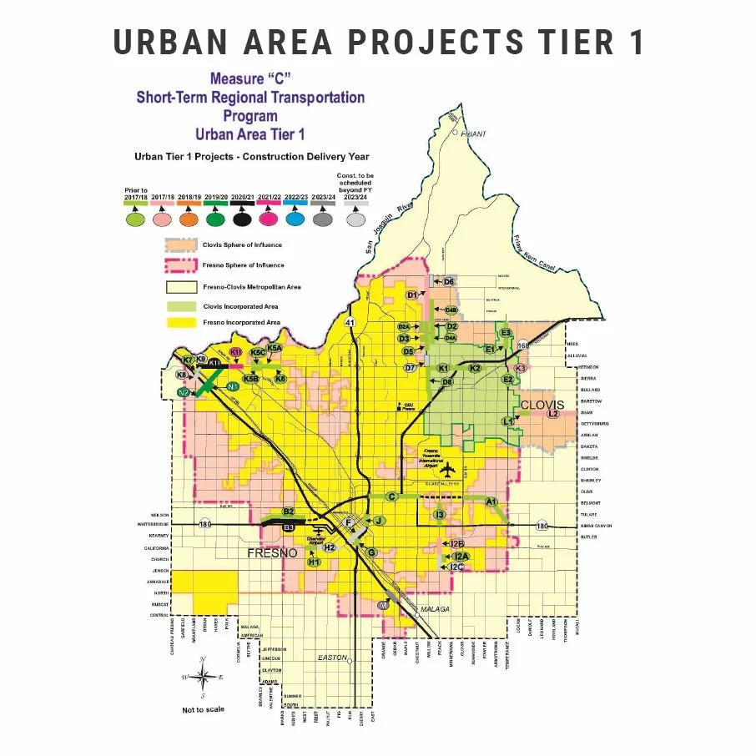

Slide 7
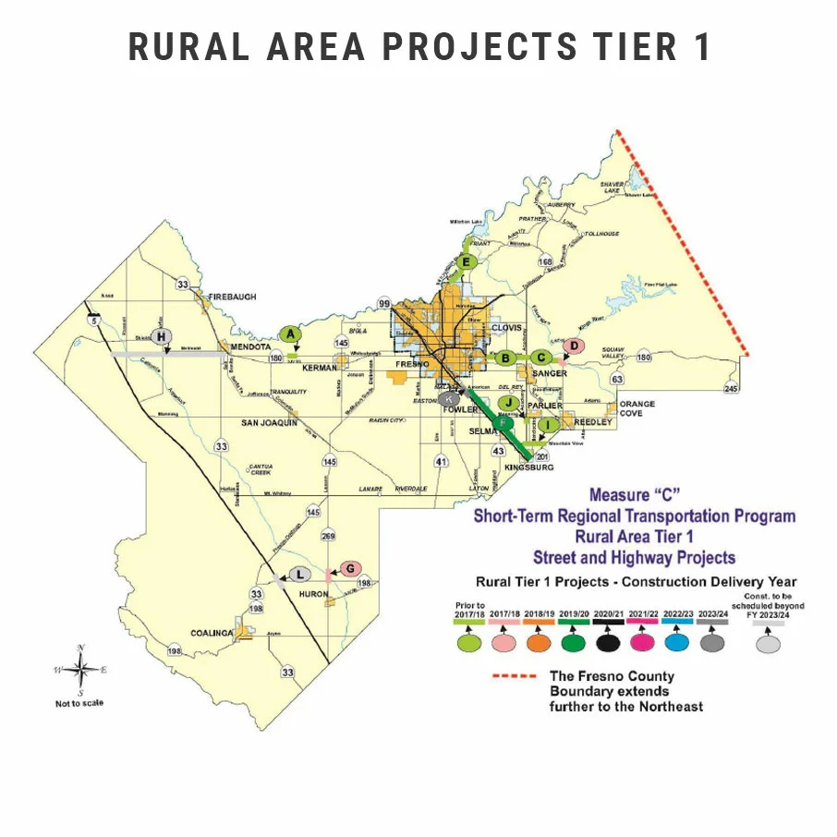

Slide 8
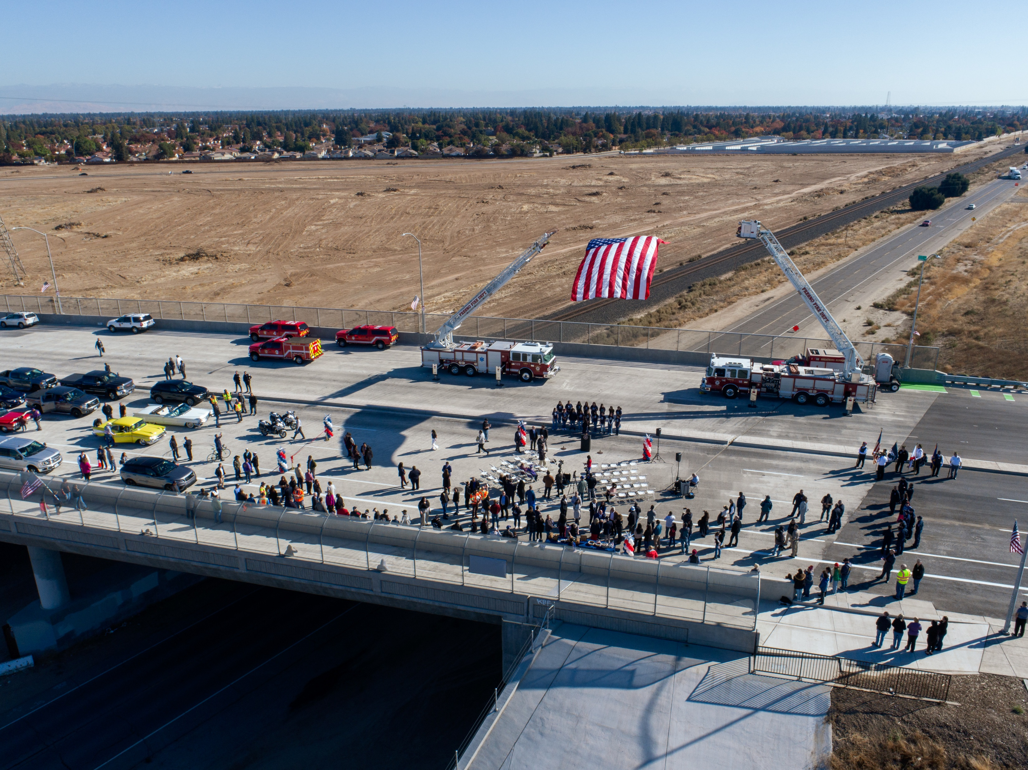
Recent/Current Projects
The Veterans Boulevard interchange, extension and grade separation project across State Route 99 opened in 2023 and included a pedestrian trail and adaptive intelligent transportation system technology to synchronize traffic operations in real time. It has helped alleviate traffic congestion at the Herdon Avenue interchange. Total cost $108,995,077.

Slide 9
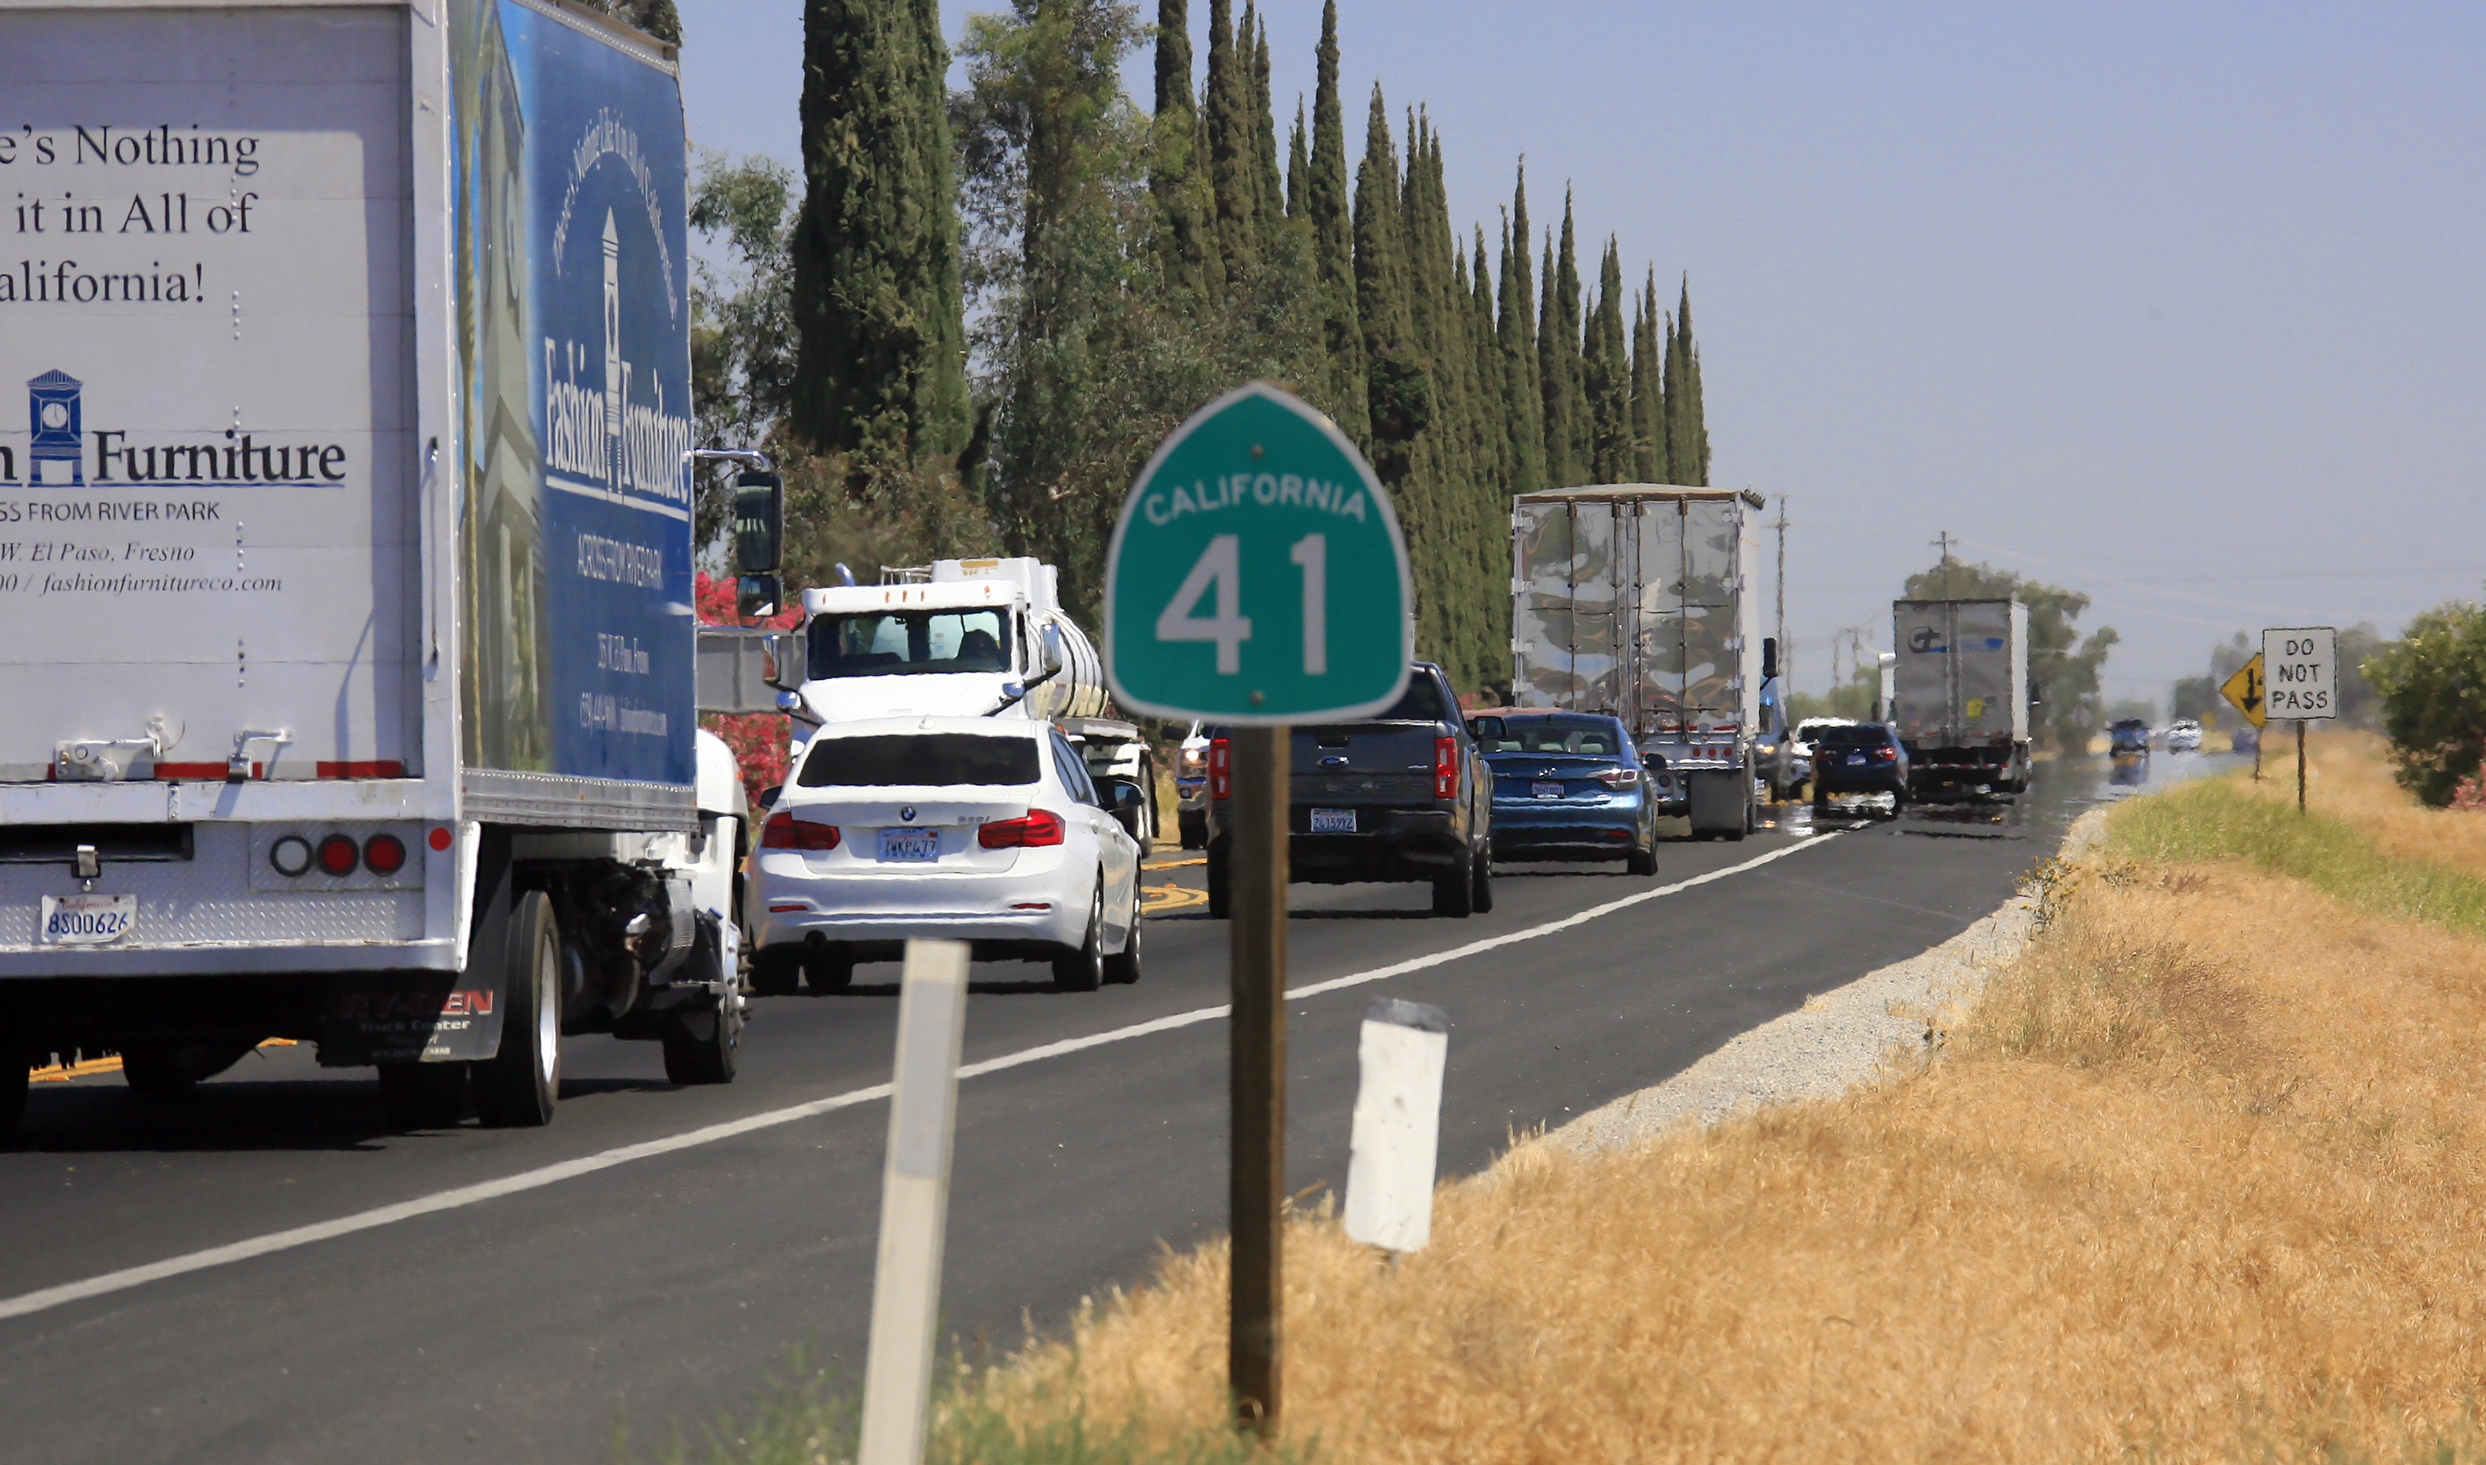
State Route 41 Widening/Gap Closure
Approximately six-mile widening from Excelsior Avenue undercrossing to one mile north of Elkhorn Avenue from two-lane conventional highway to four-lane expressway. Total budget: $94.1 million

Slide 10
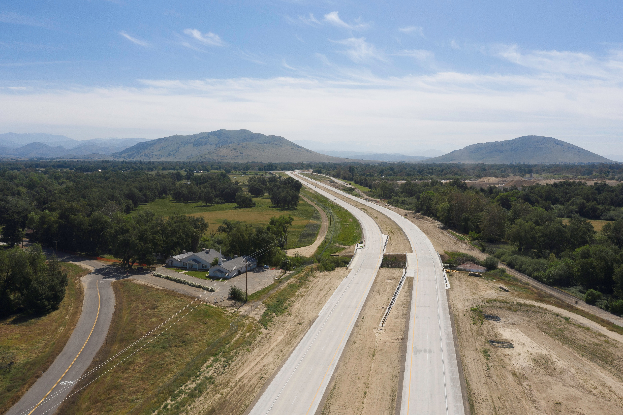
State Route 180 Extension
The State Route 180 Extension Project lengthened the four-lane expressway by 4.5 miles, from Smith Avenue to Frankwood Avenue in eastern Fresno County. The $55 million project broke ground on Oct. 12, 2017 and was finished in December 2020.

Slide 11
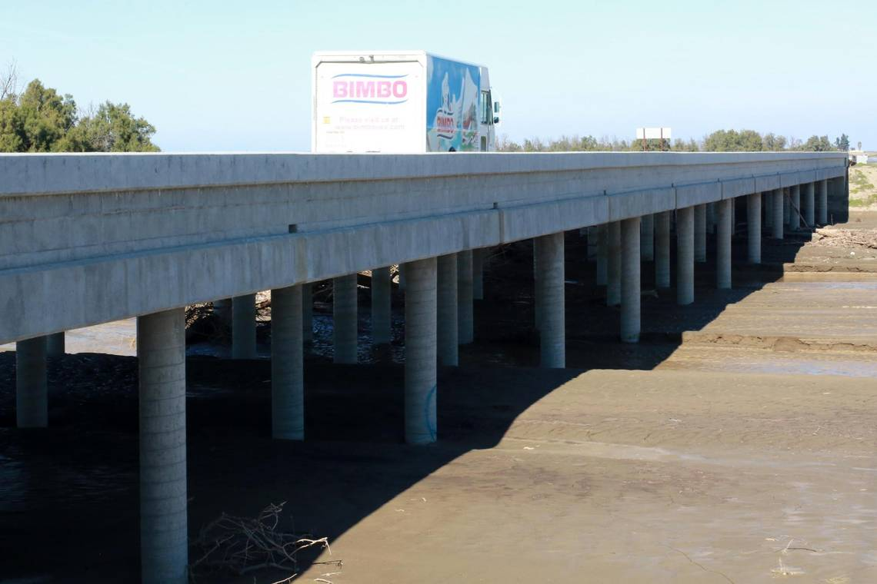
Huron ‘Heart of the Valley’ Bridge (SR 269)
The $30 million project, which opened in 2018, was designed to address flooding issues that frequently closed a section of State Route 269 (Lassen Avenue). The project involved constructing new, elevated bridges over Arroyo Pasajero Creek, and widening the channel to prevent future flooding and road closures.

Slide 12
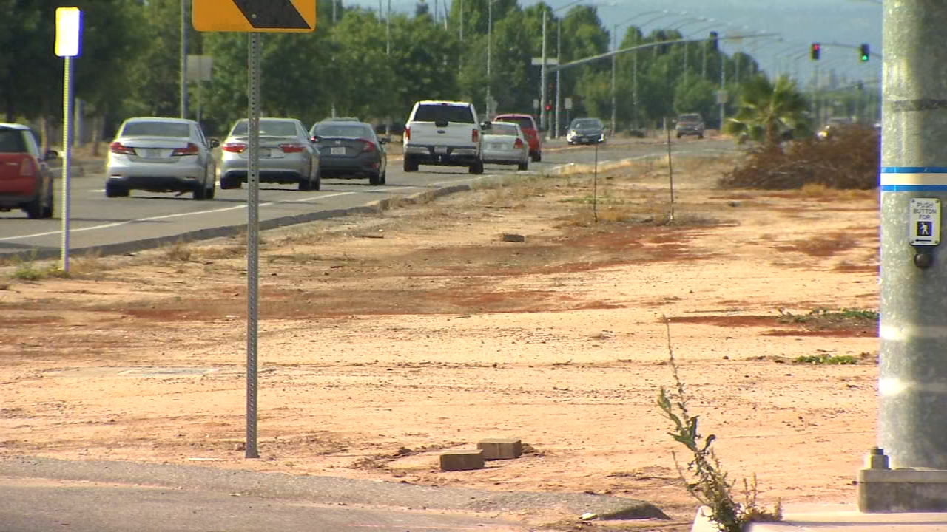
Willow Avenue Widening (Clovis)
The $5.7 million Willow Avenue Project widened the northbound lanes from Shepherd to Copper Avenues
and added:
median, curb, gutter, irrigation, landscaping, and a traffic signal at Perrin Road

Slide 13
Potential Future Projects
Major, capital projects submitted for potential funding to the 2026 Regional Transportation Plan by Caltrans and local jurisdictions include the following projects:
State Route 99/Shaw Avenue Interchange
State Route 99/Mountain View Interchange
State Route 99/Mendocino Interchange
State Route 99/Ashlan Interchange
State Route 99/43/Floral Interchange
North Avenue – State Route 41 to Orange Ave – Four Lanes
Central Ave – State Route 99 to Golden State – Four Lanes

