Slide 1
Fresno Council of Governments Measure C Steering Committee
Impacts of Measure C Renewal
July 10, 2025
Notes:
Paul or Robert – please edit as needed

Slide 2
Questions We Are Answering Today
How many miles of streets are in Fresno County?
What condition are they in?
What repairs are needed in the next 25 years?
How much funding is needed?
How does Measure C help?

Slide 3
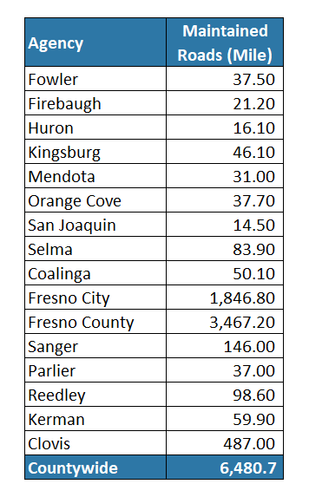
Local Street Network in Fresno County
Total Value = $6.0 Billion

Slide 4
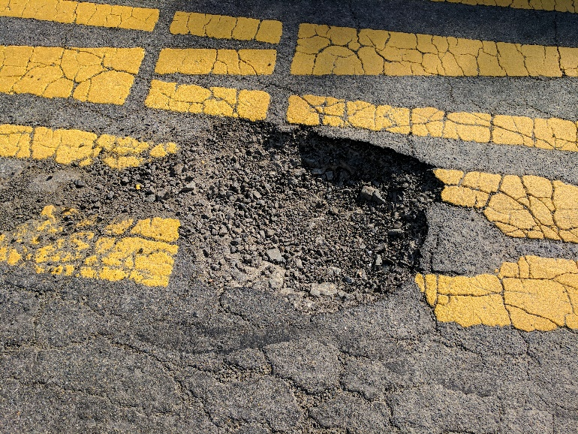
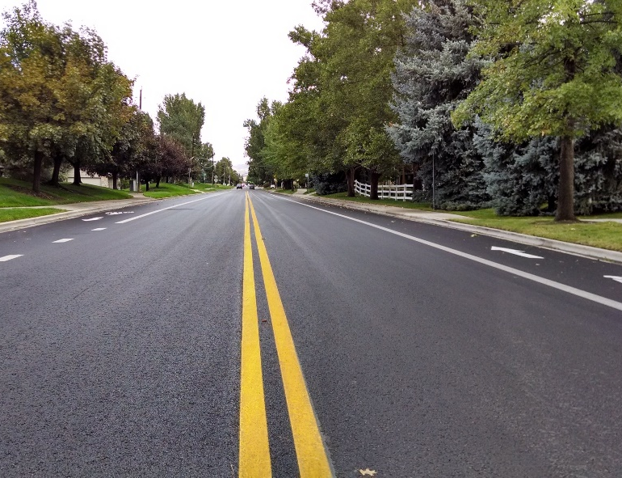
How is Pavement Condition Measured?
Condition Category
0
Very Poor/Failed
25
Poor
Pavement Condition Index (PCI)
50
Fair
70
Good/Very Good
100
Notes:
We will delete this slide if we cannot get graphic of the left

Slide 5
How is Pavement Condition Measured?
Condition Category
0
Very Poor/Failed
25
Poor
Pavement Condition Index (PCI)
50
Fair
70
Good/Very Good
100

Slide 6
What Condition Are Streets In?
2022 Statewide & 2026 Countywide average

Slide 7
PCIs of Other Cities & Counties
2022 Statewide & Countywide: 65
Counties include cities

Slide 8
Typical Construction Costs
Good 70-100
Fair 50-69
Poor 25-49
Very Poor 0-24
100
No Repairs Needed
90
Seals
$10-$17/SY
80
Preventive Maintenance
Pavement Condition Index
70
Thin Overlays
$28-$61/SY
Minor Resurfacing
60
50
Thick Overlays
$57-$90/SY
40
Major Resurfacing
30
20
Reconstruction
$90-$133/SY
Reconstruction
10
0
35%
75%
90%
Percent of Pavement Service Life

Slide 9
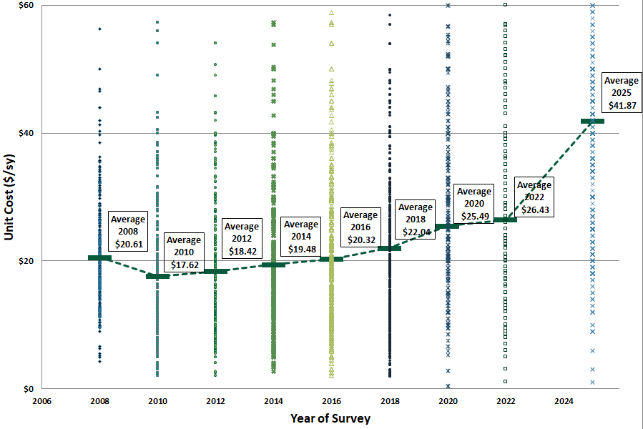
Trends in Construction Costs
Overlays
Increased 47% - 58% from 2022

Slide 10
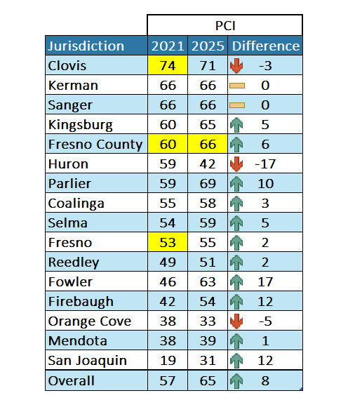
Significant Changes since 2021
Countywide PCI has increased to 65 since 2021
2021 – Fresno & County not surveyed by NCE at the time
County’s PCI 6 points higher in 2025
Unit costs have increased significantly since 2021/22
Seals – 47%
Overlays – 47% to 58%
Reconstruction – 25%

Slide 11
Future Funding Assumptions
Road Maintenance and Rehabilitation Act (RMRA) aka SB1
Reduction of 6% annually until 2035, then flat thereafter
Surface Transportation Block Grant (STBG)
Federal funding to grow 3% annually
Measure C
Estimate (2027/28) approx. $126.3 Million/year
Grows by 3% annually
30%, 40%, 50% and 60% allocated to local roads
2025 Est. Funding = $162 M/year
Notes:
Update pie chart and 2025 existing funding
Thanks for providing the Measure C base estimate. I did some simple calculations, and the cumulative Measure C with 3% inflation will be $3,394,571,463 (SC1) and $6,010,267,873 (SC2) for 20 years and 30 years, respectively. I am going to run four scenarios for each, considering that 30%, 40%, 50%, and 60% of Measure C will go towards road maintenance. Am I heading in the right direction?
I talked with our Finance Director this morning and for our base year Measure C estimate (2027-28) we are looking at $126,331,379. This would be the base number to use for the 3% annual inflation rate.

Slide 12
Estimated Funding (20-Year)
Total Pavement Funding: $4.65B
(Measure C is $1-2 B)

Slide 13
Estimated Funding (30-Year)
Total Pavement Funding: $5.08B
(Measure C is $1.8 - $3.6 B)

Slide 14
Funding Scenarios
Scenario 1: Measure C sunsets in 2027
Scenario 2: Measure C renewed (30%)
Scenario 3: Measure C renewed 20 years
Scenario 4: Measure C renewed 30 years
What are impacts on road conditions?

Slide 15
PCI Forecast

Slide 16
PCI Forecast

Slide 17
PCI Forecast

Slide 18
PCI Forecast

Slide 19
Unfunded Maintenance
+ ($2.04 B)
+ ($3.61 B)

Slide 20
Summary
Pavements represent a substantial investment ($6.0 Billion) in County
Pavement network is in Fair condition (PCI = 65 in 2026)
Scenario 1:
If Measure C Sunsets in 2027, the countywide PCI will decrease to 48
Scenario 2:
Measure C is renewed (30%) - PCI drops to 56
Scenario 3:
Measure C is renewed for 20 years (50 & 60%) – PCI will be 60 and 63, respectively.
Scenario 4:
Measure C is renewed for 30 years (50% & 60%) – PCI will be 62 and 65, respectively.
Improving PCI will require additional funding

Slide 21
Margot Yapp, PE
MYapp@ncenet.com
Shahram Misaghi, PE
SMisaghi@ncenet.com

