Slide 1



MEASURE C
E-BIKE SAFETY EDUCATION CAMPAIGN
OCTOBER 14, 2026
E-Bike Safety Education Campaign

Slide 2

OVERVIEW
MEASURE C • E-BIKE SAFETY EDUCATION CAMPAIGN
CAMPAIGN OBJECTIVE:
To maximize community safety by providing information which may help prevent e-bike related injuries and fatalities across Fresno County through a targeted educational campaign.
PAID MEDIA TACTICS:
Digital Display, Social Media Videos, Social Media Carousels, Streaming Video
CUSTOM LANDING PAGE:
ebikesafetyfresno.com has been purchased and developed with e-bike safety-related information and statistics.
PUBLIC RELATIONS:
We intend to collaborate with community partners and stakeholders to leverage their extensive and diverse networks, expanding our outreach across Fresno County.

Slide 3
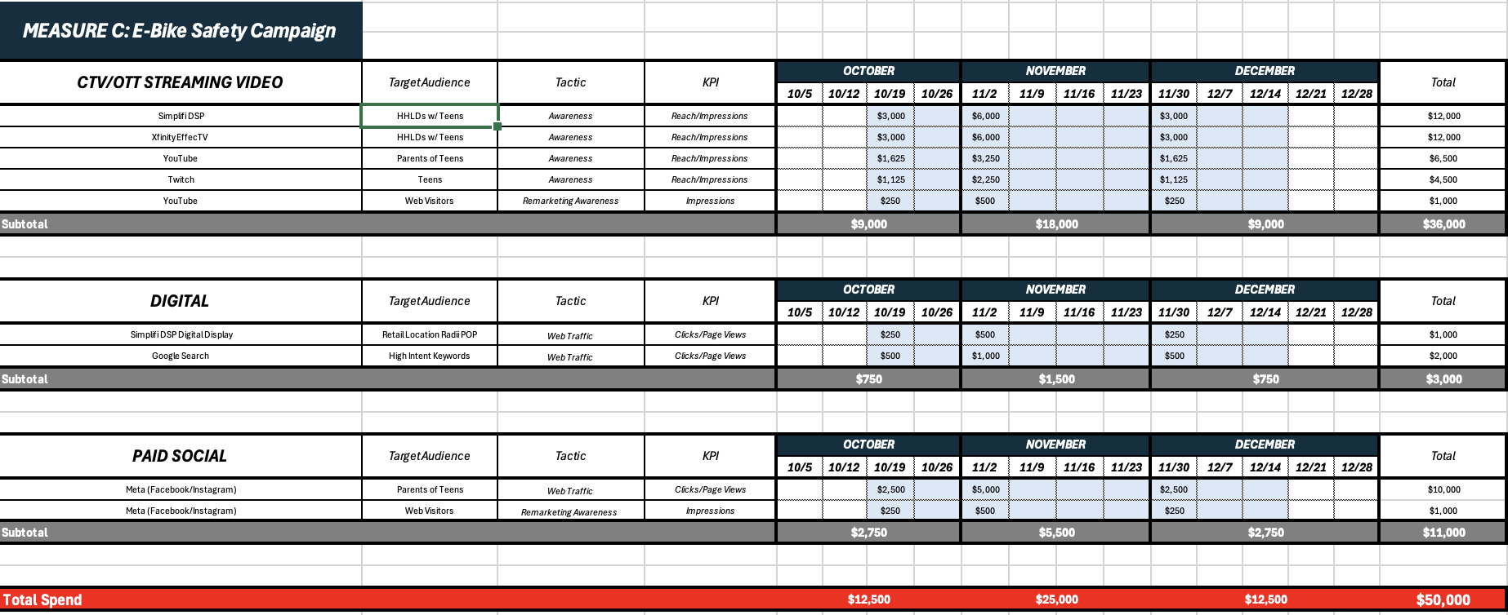
PAID MEDIA PLAN
MEASURE C • E-BIKE SAFETY EDUCATION CAMPAIGN

Slide 4



DIGITAL DISPLAY
MEASURE C • E-BIKE SAFETY EDUCATION CAMPAIGN

Slide 5

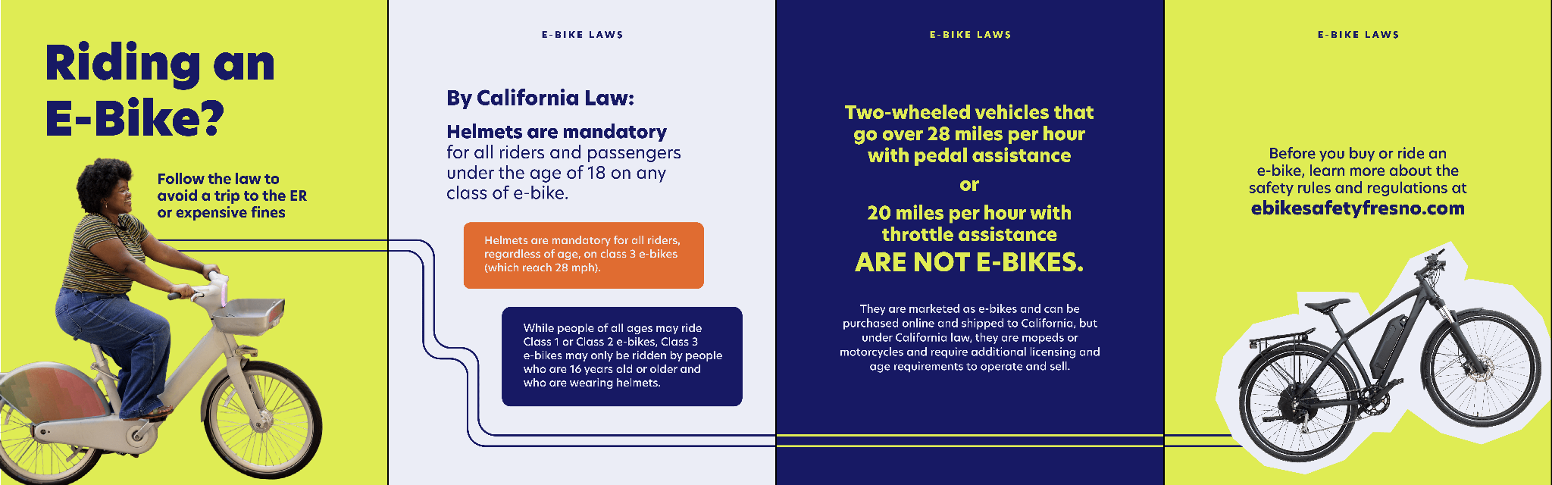

SOCIAL MEDIA CAROUSELS
3 Sets
MEASURE C • E-BIKE SAFETY EDUCATION CAMPAIGN

Slide 6


SOCIAL MEDIA VIDEOS
5 Videos
MEASURE C • E-BIKE SAFETY EDUCATION CAMPAIGN

Slide 7

STREAMING VIDEO
MEASURE C • E-BIKE SAFETY EDUCATION CAMPAIGN

Slide 8


CUSTOM LANDING
PAGE
MEASURE C • E-BIKE SAFETY EDUCATION CAMPAIGN

Slide 9




OUTREACH TOOLKIT
Safety Light
Flyer
Helmet Stickers
Poster
MEASURE C • E-BIKE SAFETY EDUCATION CAMPAIGN

Slide 10
PARTNER LIST
MEASURE C • E-BIKE SAFETY EDUCATION CAMPAIGN
TTC/PAC preview with all City Managers/Public Works Director/City Engineers/Caltrans/Transit Directors
Fresno County School Districts
JSA partners such as Educational Employees Credit Union (EECU) and others focused on education and youth programs
Boys & Girls Club of Fresno County
Law Enforcement/Public Safety: Police Unions, Fresno County Sheriff’s Office
Valley Children’s Hospital, Community Health Systems, SAMC, United Health Centers
Fresno County Public Libraries
COMMUNITY ORGANIZATIONS:
Highway City Community Development
Centro La Familia
AMOR Wellness Center
Focus Forward
Girl Scouts of Central California South

Slide 11
THANK YOU

